Slide 1

Fitness tracker e-commerce Product
- By SHIVAM Mishra

Slide 2
PROJECT CONTEXT
EDA
Read the file & Basic Codes(eg. head, shape,etc.)
Generated the Report using ydataprofiling
Visualization
Removing Outlier
L1 and L2
Cross Validation
Regression (Linear, Decision Tree, Random Forest, XGBoost)
ANOVA TEST
GridSearchCV
Pickle
OneHotEncoder

Slide 3
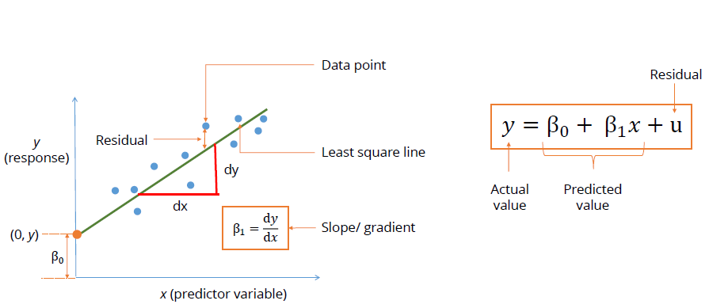
What is linear regression ?
Linear regression in supervised learning technique which is been used in machine learning.
Its main task is to determine the relationship between an independent (y) and dependent(x) variable in which both are continuous.
In other words it is used for predicting a continuous quantity.

Slide 4

When do we use Linear Regression?
Linear regression has many practical uses. Most applications fall into one of the following two broad categories: If the goal is prediction, or forecasting, or error reduction, linear regression can be used to fit a predictive model to an observed data set of values of the response and explanatory variables
Also used in trends and sales, assessment of risk in financial services and insurance domain.

Slide 5
ADVANTAGES OF LINEAR REGRSSION | DISADVANTAGES OF LINEAR REGRESSION
Linear Regression performs well when the dataset is linearly separable. We can use it to find the nature of the relationship among the variables. | Main limitation of Linear Regression is the assumption of linearity between the dependent variable and the independent variables. In the real world, the data is rarely linearly separable. It assumes that there is a straight-line relationship between the dependent and independent variables which is incorrect many times.
Linear Regression is easier to implement, interpret and very efficient to train. | Prone to noise and overfitting: If the number of observations are lesser than the number of features, Linear Regression should not be used, otherwise it may lead to overfit because is starts considering noise in this scenario while building the model.
Linear Regression is prone to over-fitting but it can be easily avoided using some dimensionality reduction techniques, regularization (L1 and L2) techniques and cross-validation. i.e. L1 – LASSO, L2 - Ridge | Prone to outliers: Linear regression is very sensitive to outliers (anomalies). So, outliers should be analyzed and removed before applying Linear Regression to the dataset.
 | Prone to multicollinearity: Before applying Linear regression, multicollinearity should be removed (using dimensionality reduction techniques) because it assumes that there is no relationship among independent variables.

Slide 6
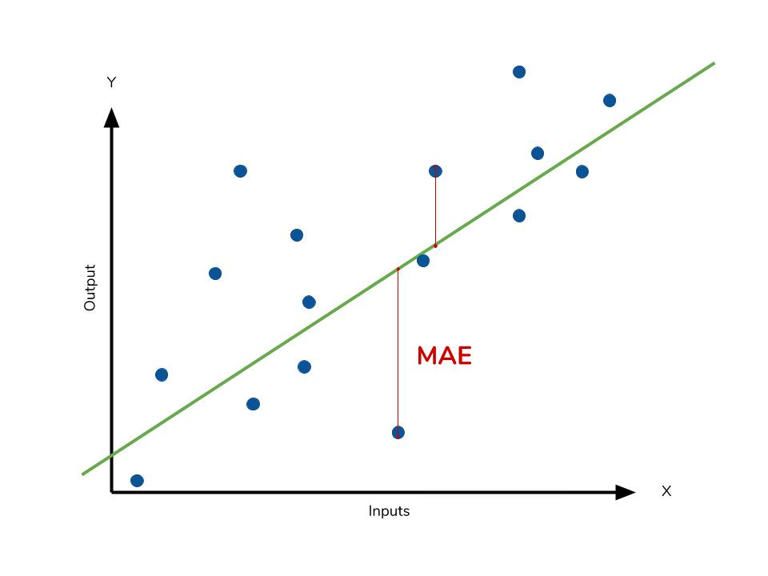

Regression Metrics : - A) Mean Absolute Error
One way to measure error is by using absolute error to find the predicted distance from the true value. The mean absolute error takes the total absolute error of each example and averages the error based on the number of data points. By adding up all the absolute values of errors of a model we can avoid canceling out errors from being too high or below the true values and get an overall error metric to evaluate the model on.

Slide 7
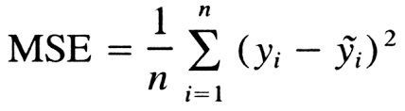
B) Mean Squared Error
Mean squared is the most common metric to measure model performance. In contrast with absolute error, the residual error (the difference between predicted and the true value) is squared.
Some benefits of squaring the residual error is that error terms are positive, it emphasizes larger errors over smaller errors, and is differentiable. Being differentiable allows us to use calculus to find minimum or maximum values, often resulting in being more computationally efficient.

Slide 8
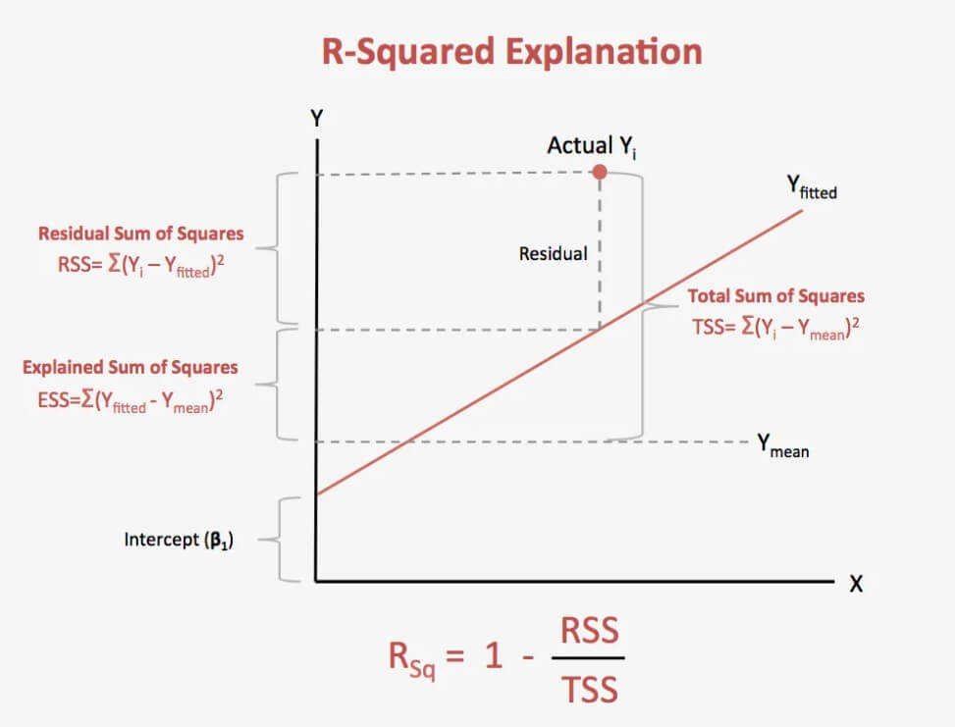
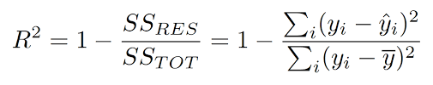
C) R squared method
Its called coefficient of determination. The values for R2 range from 0 to 1, and it determines how much of the total variation in Y is explained by the variation in X. A model with an R2 of 0 is no better than a model that always predicts the mean of the target variable, whereas a model with an R2 of 1 perfectly predicts the target variable. Any value between 0 and 1 indicates what percentage of the target variable, using this model, can be explained by the features. A model can be given a negative R2 as well, which indicates that the model is arbitrarily worse than one that always predicts the mean of the target variable.

Slide 9
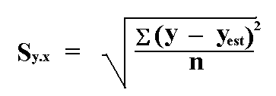
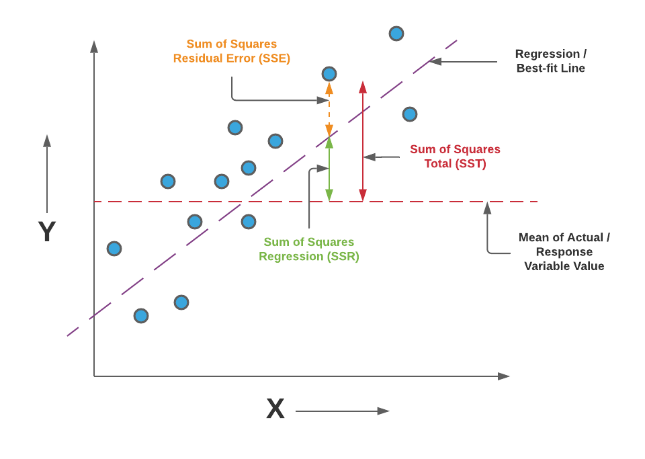
Standard error of estimate
The standard error of the estimate is a measure of the accuracy of predictions. Recall that the regression line is the line that minimizes the sum of squared deviations of prediction (also called the sum of squares error). The standard error of the estimate is closely related to this quantity and the formula is :

Slide 10
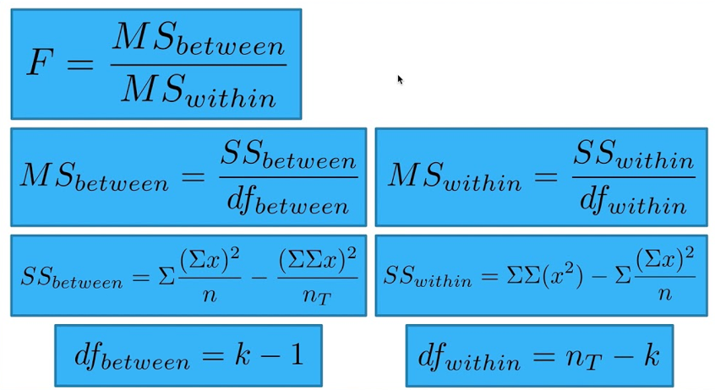
ANOVA TEST
Analysis of variance, or ANOVA, is a statistical method that separates observed variance data into different components to use for additional tests.
A one-way ANOVA is used for three or more groups of data, to gain information about the relationship between the dependent and independent variables.
If no true variance exists between the groups, the ANOVA's F-ratio should equal close to 1.

Slide 11
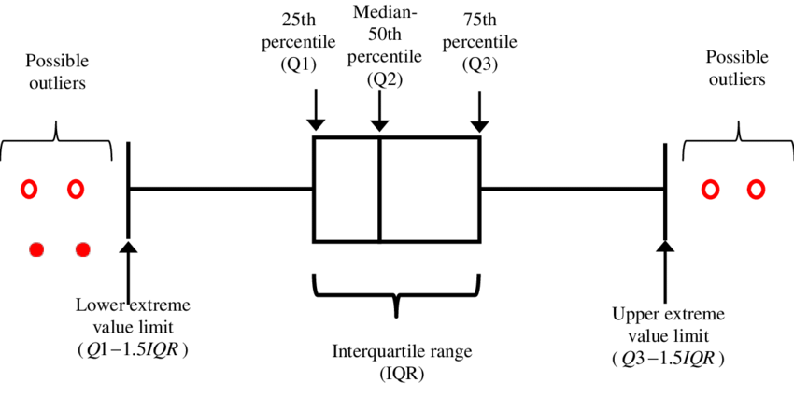
What is outlier? Why outlier analysis?
An outlier is an object that deviates significantly from the rest of the objects. They can be caused by measurement or execution error. The analysis of outlier data is referred to as outlier analysis or outlier mining.
Most data mining methods discard outliers noise or exceptions, however, in some applications such as fraud detection, the rare events can be more interesting than the more regularly occurring one and hence, the outlier analysis becomes important in such case.
I have used IQR to remove Outlier –

Slide 12
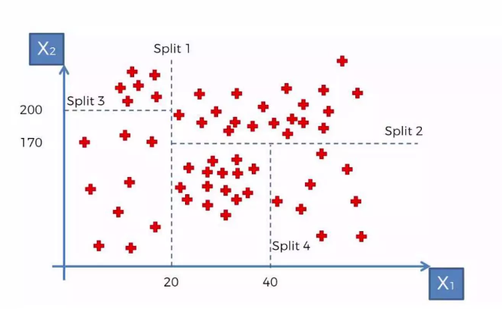
Decision Tree regression
Decision trees is a type of supervised machine learning algorithm that is used by the Train Using AutoML tool and classifies or regresses the data using true or false answers to certain questions.
Decision Tree Regressor tries to predict a continuous target variable by cutting the feature variables into small zones, and each zone will have one prediction. We will begin with one continuous variable and then two continuous variables.
We will not use categorical variables since for decision trees, continuous variables are ultimately treated like categorical data when the splits are made.

Slide 13
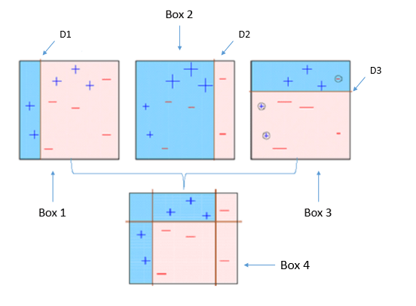
What is XGBoost?
Stands for:
eXtreme Gradient Boosting.
XGBoost is a powerful iterative learning algorithm based on gradient boosting.
XGBoost is an efficient implementation of gradient boosting that can be used for regression predictive modeling.
Robust and highly versatile, with custom objective loss function compatibility.

Slide 14
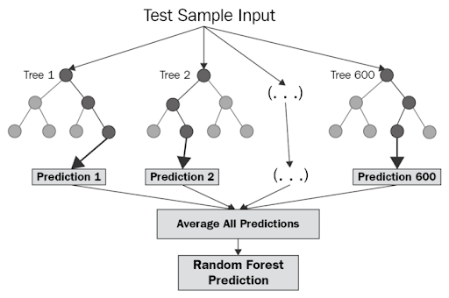

Random forest regressor
Random forest regression is a supervised learning algorithm and bagging technique that uses an ensemble learning method for regression in machine learning.
The trees in random forests run in parallel, meaning there is no interaction between these trees while building the trees.
How Does Random Forest Regression Work?
Random forest operates by constructing a multitude of decision trees at training time and outputting the class that’s the mode of the classes (classification) or mean prediction (regression) of the individual trees.

Slide 15
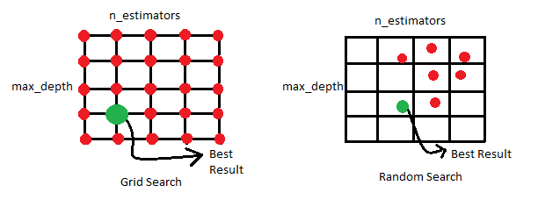
gridsearchcv
Define :- GridSearchCV is the process of performing hyperparameter tuning in order to determine the optimal values for a given model.
What is GridSearchCV used for?
GridSearchCV is a technique for finding the optimal parameter values from a given set of parameters in a grid. It’s essentially a cross-validation technique. The model as well as the parameters must be entered. After extracting the best parameter values, predictions are made.

Slide 16

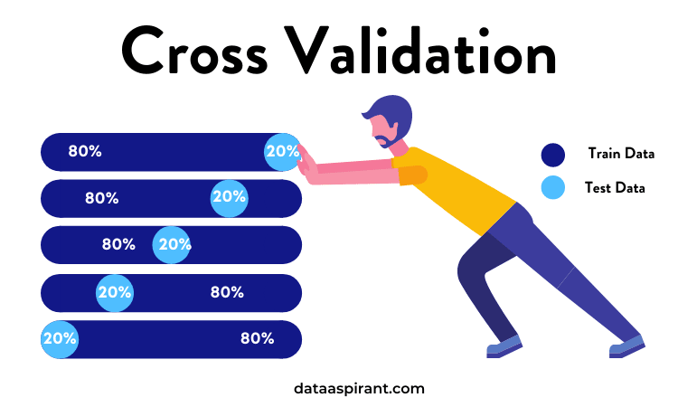
What is the use of cross validation?
Cross validation is a technique used in machine learning to evaluate the performance of a model on unseen data. It involves dividing the available data into multiple folds or subsets, using one of these folds as a validation set, and training the model on the remaining folds.
The three steps involved in cross-validation are as follows :
1. Reserve some portion of sample data-set.
2. Using the rest data-set train the model.
3. Test the model using the reserve portion of the data-set.

Slide 17

Why we use L1 and l2 model?
Define : - L1 Regularization, also called a lasso regression, adds the “absolute value of magnitude” of the coefficient as a penalty term to the loss function.
Define : - L2 Regularization, also called a ridge regression, adds the “squared magnitude” of the coefficient as the penalty term to the loss function.
L1 regularization, which generates sparse solutions and is based on the absolute values of the model's parameters, is helpful for feature selection.
In contrast, L2 regularization yields non-sparse solutions and is based on the squares of the model's parameters, making it beneficial for building simpler models.

Slide 18
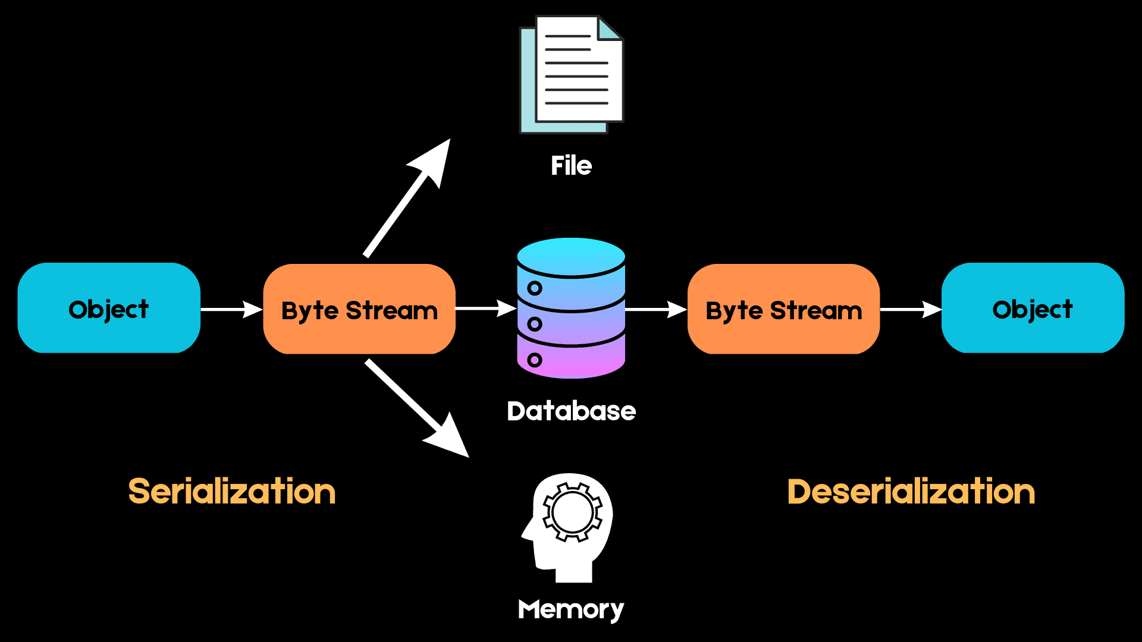
Pickle
Pickle is a very powerful python library that allows users to store and later open objects.
We use .pkl as an extension.
We can use rb for read in binary and wb for write in binary.
Pickle allows for flexibility when deserializing objects. You can easily save different variables into a Pickle file and load them back in a different Python session, recovering your data exactly the way it was without having to edit your code.

Slide 19

Thank You

